Slide 1

UAV Planning, Autonomous Tracking, and Obstacle Identification and Avoidance
Álvaro Melgosa Pascual
1
Notes:
UAV=Unmanned Aerial Vehicle

Slide 2

Motivation
Notes:
First of all, why am I doing this?
What is the purpose of this Thesis?

Slide 3
Motivation
Safety
Notes:
Most important issue in aerospace industry
UAVs can be considered part of aerospace industry, but not so safe
Disembarking the human eliminates intuitive sensing (inertial, visual, noise…)
Sensing has to be done by sensors and interpreted by computers for safe autonomous flight

Slide 4
Safety
Motivation
Improved
OCAS
Notes:
OCAS (similarly to TCAS in commercial aircraft) tries to eliminate the posibility of a physical collision of the UAV with its surroundings
OCAS operates as intermediate functional layer between operator and UAV

Slide 5
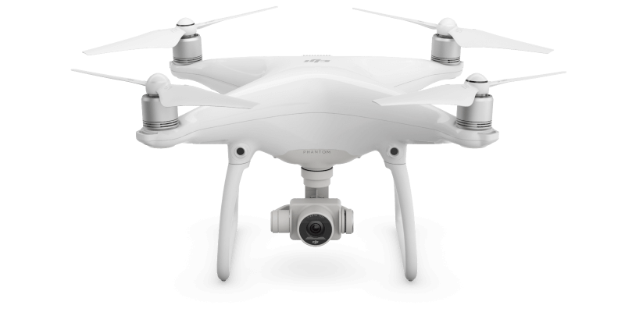
Example: DJI Phantom 4
Motivation
Source: dji.com
Notes:
Why is it important to have a reliable Obstacle Collision Avoidance System?
DJI recently (March 2016) built one into their Phantom 4
Based on stereoscopic cameras

Slide 6
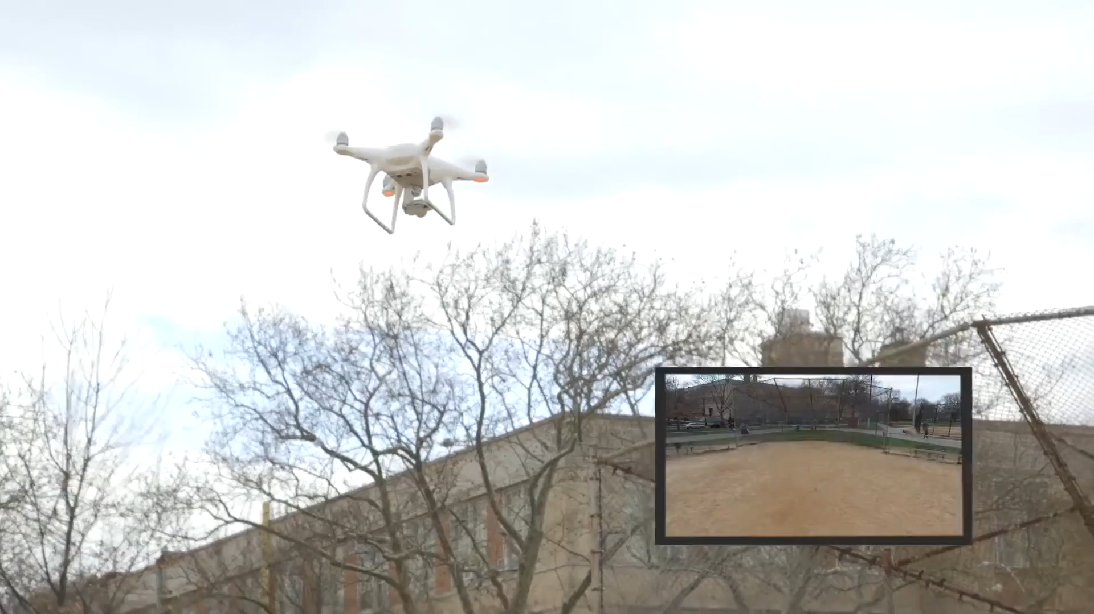
Regular operation
Motivation
Source: gizmodo.com
Notes:
Gizmodo journalists were testing the new features of the UAV
In particular the Emergency mode, that stops the vehicle when a collision is about to happen

Slide 7
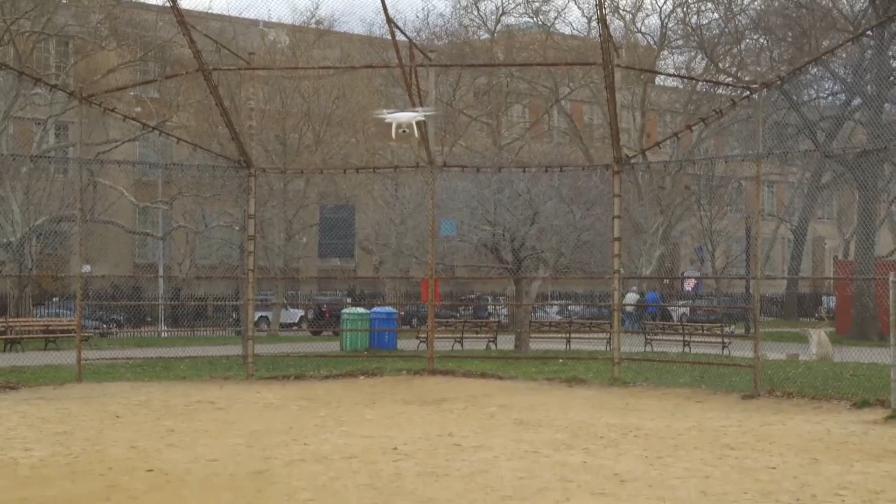
Faulty operation
Motivation
Source: gizmodo.com
Notes:
However, there are sometimes (Sport mode) that the Emergency mode is deactivated
The journalist was relying on that safety system while testing other features, and accidentally crashed the UAV

Slide 8
Objectives
Motivation
Design an OCAS
Integrate is within existing UAVs
Build a working prototype
Demonstrate that safety is improved

Slide 9
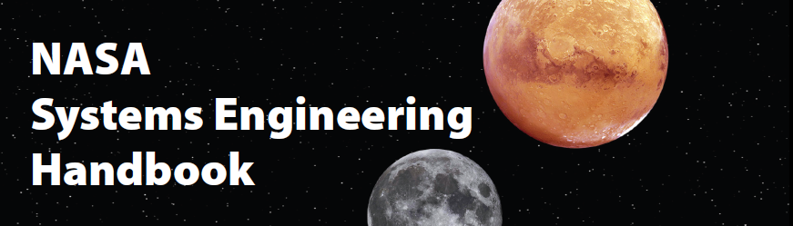
Methodology
Motivation
Systems Engineering collects and organises all the information needed to understand the whole problem, explores it from all angles, and then finds the most appropriate system solution.
Richard Beasley, president of INCOSE UK, 2015
Notes:
Systems Engineering provides a set of tools that facilitate the systematic analysis of the needs of any system
INCOSE = INternational COuncil of Systems Engineering

Slide 10
Result
Motivation
A system that is:
Reliable
Modular
Expandable
Open
Notes:
Result: a system that is reliable, modular, expandable and open
Open is a important property since it allows future research and improvements
It constitutes a base on which technology can be further developed and fitted to any specific need

Slide 11
1.
Design
2.
Implementation
Outline
3.
Testing

Slide 12
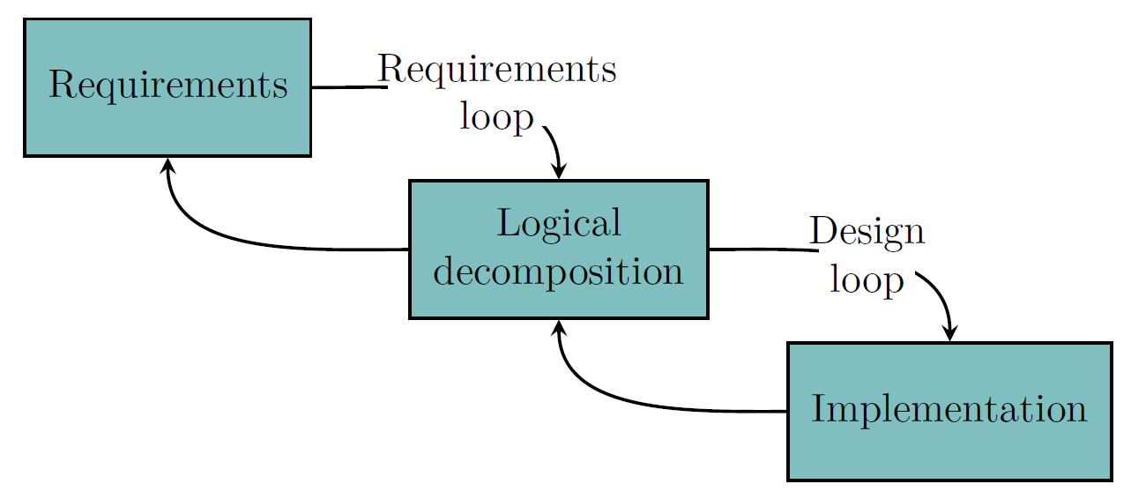
The design process
Design
Notes:
The design process in Systems Engineering is iterative, and the product is improved in each iteration.
In the Requirements loop, it is defined what the system must do (requirements) and the elements needed to perform all those functions (logical decomposition)
In the Design loop, the system is designed and built according to the architectures defined in the Logical decomposition step, identifying issues and propagating back if needed

Slide 13
Requirements
Design
A statement or characteristic of something that is needed.
Notes:
A requirement is a statement or characteristic of something that is needed.
For the case of the OCAS, they represent the set of features and objectives that the system must accomplish to meet the final goal of the OCAS: Avoid collisions against Obstacles
The requirements document is accessible to the whole design team and should be constantly updated (live or evolving document)
In Systems Engineering requirements drive design

Slide 14
Requirements
Come from:
Customer needs → Motivation
Regulations
Defined goals and objectives
Assumptions and constraints
Design
Notes:
The requirements (what the system must do) can come from:
Motivation instead of customer needs because there is no customer

Slide 15
Requirements
The OCAS shall:
Improve the operational safety of the UAV
Avoid collisions with the detected obstacles
Work independently of the UAV
Not interfere with existing UAV functions
Be accessible from the GCS
Be operable after a short training by any pilot
Design
Notes:
Example of most significant requirements.
“Avoid collisions” can be thought as derived from the “Improve operational safety” requirement
Work independently -> To enhance modularity and upgradeability
Not interfere -> Change behaviour of the UAV only when there is risk of collision
GCS = Ground Control Station

Slide 16
Design

Slide 17
Design

Slide 18
Implementation

Slide 19
Implementation

Slide 20
Implementation

Slide 21
Testing

Slide 22
Testing

Slide 23
Testing

Slide 24
Conclusions

Slide 25
Conclusions

Slide 26
Conclusions

